Slide 1
Classes and Objects in Java

Slide 2
OO Analysis
OO SDLC has three phases
  OO Analysis (Identifying classes and their relationships)
  OO Design (Designing the data members and methods of a class)
  OO Implementation (Implementing the design using an OOP language)
An easy way to identify the classes are to identify the nouns in the requirements specifications
For example, a system to automate an Insurance company will have to manage the information about the Policy Holders
  class PolicyHolder
Notes:
The OO SDLC has three phases - OO Analysis, OO Design and OO Implementation.
In OO Analysis, the analyst will identify the classes that are required for the program. There are formal methodologies for performing this activity with the help of UML diagrams. An easy way to identify the classes are to identify the nouns in the problem specification. Following is a statement from the problem specification of an insurance company - “Customers can obtain a policy from any of the company’s offices and become a policy holder”. Here the analyst will identify that Policy and PolicyHolder as two classes. Note that Customer is also a noun here, but it is just another name for the PolicyHolder. Compared to the name Customer, the name PolicyHolder is better as it conveys better idea in this particular problem. Once the classes are identified, the next step is to identify the relationship between them. For example, “PolicyHolder has a Policy”.

Slide 3
OO Design
Once the class is identified, we have to identify the data members and methods required in the class
Data Members
  Policy No
  Name of the Policy Holder
  Address
  Details of the Policy
  Bonus Amount
  etc…
Methods
  Set the Policy No
  Get the Policy No
  Set the Name of the Policy Holder
  Get the Name of the Policy Holder
  etc…
Notes:
In OO Design, the designed identifies the data members and methods of the classes. This activity may lead to identification of some more classes which is actually a part of OO Analysis. For example, while designing the class PolicyHolder, the designer identifies the data members Date of Birth, Date Insured and Date of Maturity. It would be better to have a separate class called Date and make these data members objects of the Date class. Thus OO Analysis and OO Design are essentially iterative.
In OO Implementation, the programmer actually writes the classes based on the design using any OO programming language.

Slide 4
Access Modifiers – private and public
Data members are usually kept private
  It is accessible only within the class
The methods which expose the behavior of the object are kept public
Key feature of OOP
  Encapsulation (binding of code and data together)
  State (data) is hidden and Behavior (methods) is exposed to external world

Slide 5
Classes in Java
public class PolicyHolder{
private int policyNo;
private double bonus;
//Other Data Members
public void setPolicyNo(int no){policyNo = no;}
public int getPolicyNo(){return policyNo;}
public void setBonus(char amount){bonus = amount;}
public double getBonus(){return bonus;}
//Other Methods
}
Data Members (State)
Methods (Behavior)
The main method may or may not be present in a class depending on whether it is a starter class or not

Slide 6
Creating Objects in Java (1/2)
In Java, all objects are created dynamically
  The operator new is used for dynamic memory allocation
The following statement creates an object of the class Student
new PolicyHolder()
The above statement returns a reference to the newly created object
Notes:
Creation of objects and arrays are very similar in Java.

Slide 7
Creating Objects in Java (2/2)
The following statement creates a reference to the class PolicyHolder
The reference policyHolder can be used for referring to any object of type PolicyHolder
PolicyHolder policyHolder;
//Declare a reference to class PolicyHolder
PolicyHolder policyHolder;
//Create a new PolicyHolder object
//Make policyHolder refer to the new object
PolicyHolder policyHolder = new PolicyHolder();

Slide 8
Invoking methods in a class
The following statement also creates a new PolicyHolder object and assigns its reference to policyHolder
PolicyHolder policyHolder = new PolicyHolder();
All the public members of the object can be accessed with the help of the reference
PolicyHolder policyHolder = new PolicyHolder();
policyHolder.setPolicyNo(20);
System.out.println(policyHolder.getPolicyNo());
The reference can be seen as the name of an object
Notes:
For using a Policy object, a programmer need not know the internal implementation details of the class. One needs to know only the public methods to use a Policy object. Abstraction is achieved by hiding the irrelevant implementation details and exposing the relevant interface details.
If policyHolder is a reference to a PolicyHolder object, there exists data members like policyHolder.policyNo and policyHolder.bonus. But, these data members are private and hence could not be accessed directly from any code that is written outside the class. Such code should depend on the public methods to access these data members. Data hiding or encapsulation is thus achieved.

Slide 9
The this Reference (1/2)
The methods in a class have a reference called this
  “this” reference will refer to the object that has invoked the method
  When the method getPolicylNo is invoked by an object x, the usage of “this” in this method refers to x
public int getPolicyNo(){
return policyNo;
//return this.policyNo
//These statements are similar
}

Slide 10
this Reference (2/2)
The this reference can be used in some cases to improve the readability of a program
public class PolicyHolder{
private int policyNo;
private double bonus;
//Other Data Members
public void setPolicyNo(int policyNo){this.policyNo = policyNo;}
public int getPolicyNo(){return policyNo;}
public void setBonus(char bonus){this.bonus = bonus;}
public double getBonus(){return bonus;}
//Other Methods
}

Slide 11
Constructors (1/5)
A constructor is a special method that is called to create a new object
Calling the constructor
PolicyHolder policyHolder = new PolicyHolder();
It is not mandatory for the coder to write a constructor for the class
It can be seen as a readily available, implicit method in every class

Slide 12
Constructors (2/5)
The coder can write a constructor in a class, if required
If a user defined constructor is available, it is called just after the memory is allocated for the object
If no user defined constructor is provided for a class, the implicit constructor initializes the member variables to its default values
  numeric data types are set to 0
  char data types are set to null character(‘\0’)
  boolean data types are set to false
  reference variables are set to null
Notes:
The constructor initializes the data members of an object to some default values. Note that local variables of a method are not initialized automatically and using a variable that is not initialized will result in a compilation error in the program.

Slide 13
Constructors (3/5)
The user defined constructor is usually used to initialize the data members of the objects to some specific values, other than the default values
A constructor method
  will have the same name as that of the class
  will not have any return type, not even void

Slide 14
Constructors (4/5)
public class PolicyHolder{
//Data Members
public PolicyHolder(){
bonus = 100;
}
//Other Methods
}
User defined Constructor
PolicyHolder policyHolder = new PolicyHolder();
//policyHolder.bonus is initialized to 100

Slide 15
Method Overloading (1/3)
Two or more methods in a Java class can have the same name, if their argument lists are different
Argument list could differ in
  No of parameters
  Data type of parameters
  Sequence of parameters
This feature is known as Method Overloading

Slide 16
Method Overloading (2/3)
Calls to overloaded methods will be resolved during compile time
  Static Polymorphism
void print(int i){
System.out.println(i);
}
void print(double d){
System.out.println(d);
}
void print(char c){
System.out.println(c);
}
Notes:
When the overloaded methods are invoked, JVM will choose the appropriate method based on the arguments used for invocation. For example, if the print method is invoked with an int argument, the overloaded print method that accepts an int parameter will be chosen by the JVM.

Slide 17
Method Overloading (3/3)
void add (int a, int b)
void add (int a, float b)
void add (float a, int b)
void add (int a, int b, float c)
void add (int a, float b)
int add (int a, float b)
Overloaded methods
Not overloading. Compiler error.

Slide 18
Overloading the Constructors
Just like other methods, constructors also can be overloaded
The constructor without any parameter is called a default constructor

Slide 19
Constructors (5/5)
public class PolicyHolder{
//Data Members
public PolicyHolder(){
bonus = 100;
}
public PolicyHolder(int policyNo, double bonus){
this.policyNo = policyNo;
this.bonus = bonus;
}
//Other Methods
}
PolicyHolder policyHolder1 = new PolicyHolder();
//policyHolder1.policyNo is 0 and bonus is 100
PolicyHolder policyHolder = new PolicyHolder(1, 200);
//policyHolder1.policyNo is 1 and bonus is 200

Slide 20
Memory Allocation (1/2)
All local variables are stored in a stack
  These variables are de-allocated in a last in first out order as soon as the method terminates
All dynamically allocated arrays and objects are stored in heap
  They need not be de-allocated in any specific order
  They can be garbage collected (removed from the memory) as and when their use is over

Slide 21
Memory Allocation (2/2)
public class PolicyHolder{
private int policyNo;
private double bonus;
//Other Data Members
public void sample(int x){
int y;
//More Statements
}
//More Methods
}
class Test{
public static void main(String [] args){
PolicyHolder policyHolder;
        policyHolder = new PolicyHolder();
}
}
Data members of the class are stored in the heap along with the object. Their lifetime depends on the lifetime of the object
Local variables x and y are stored in the Stack
Local variable policyHolder is stored in the Stack
Dynamic objects will be stored in the heap

Slide 22
Lifetime of objects (1 of 2)
Policy policy1 = new Policy();
Policy policy2 = new Policy();
The two Policy objects are now living
on the heap
  References: 2
  Objects: 2
Policy policy3 = policy2;
  References: 3
  Objects: 2
policy1
1
policyNo
bonus
heap
2
policyNo
bonus
policy2
policy1
1
policyNo
bonus
2
policyNo
bonus
policy3
heap
policy2

Slide 23
Lifetime of objects (2 of 2)
policy1
policy3 = policy1;
  References: 3
  Objects: 2
policy2 = null;
  Active References: 2
  null references: 1
  Reachable Objects: 1
  Abandoned objects: 1
1
policyNo
bonus
policy3
2
policyNo
bonus
heap
policy2
policy1
1
policyNo
bonus
policy3
heap
2
policyNo
bonus
This object can be garbage collected (Can be Removed from memory)
Null reference
policy2

Slide 24
Garbage Collection
In programming languages like C and C++, the programmer has to de-allocate all dynamic memory
An object that is not referred by any reference variable will be removed from the memory by the garbage collector
  Automatic Garbage Collection
  If a reference variable is declared within a function, the reference is invalidated soon as the function call ends
  Programmer can explicitly set the reference variable to null to indicate that the referred object is no longer in use
Primitive types are not objects and they cannot be assigned null
Notes:
A major difficulty in dynamic memory allocation in C/C++ was that the programmer is responsible for de-allocating the dynamic memory at the right time. Even though experienced programmers can do this very well, beginners and average programmers often missed the statements for de-allocated which led to memory-leak in many systems.
The Automatic Garbage Collection of Java de-allocates the dynamic memory automatically when this memory is no more used by the program. This relieves the programmer from the burden of memory de-allocation.

Slide 25
Array of Objects
An array of objects is created as follows
PolicyHolder [] policyHolder = new PolicyHolder[3];
/*3 PolicyHolder references policyHolder[0], policyHolder[1] and policyHolder[2] are created and all 3 references are null*/
for(int i = 0; i < policyHolder.length; ++i){
policyHolder[i] = new PolicyHolder();
//Creating PolicyHolder object
}
for(int i = 0; i < policyHolder.length; ++i){
System.out.println(policyHolder[i].getPolicyNo());
}

Slide 26
Object as Method Arguments and Return Types (1/2)
Objects and arrays can be passed to a method by passing their references as arguments
Similarly, they can be returned from a method by returning their references
public class PolicyHolder{
//Data Members and Other Methods
public boolean isSame(PolicyHolder policyHolder){
return this.policyNo == policyHolder.policyNo;
}
}
if (policyHolder1.isSame(policyHolder2)){
//Statements
}

Slide 27
Object as Method Arguments and Return Types (2/2)
public class PolicyHolder{
//Data Members and Other Methods
public PolicyHolder getObject(){
PolicyHolder policyHolder = new PolicyHolder();
policyHolder.policyNo = policyNo;
policyHolder.bonus = bonus;
//More Statements
return policyHolder;
}
}
policyHolder2 = policyHolder1.getObject();

Slide 28
The static keyword
The static keyword can be used in 3 scenarios:
  For class variables
  For methods
  For a block of code

Slide 29
Static Data Members
Static data is a data that is common to the entire class
Assume that the class PolicyHolder wants to keep track of the total number of Policy Holders
  The data common to the entire class
  An int data member total should be declared as static
  A single copy of total will be shared by all instances of the class
public class PolicyHolder{
private int policyNo;
private double bonus;
private static int total;
//Other Data Members and Methods
}
The static variable is initialized to 0, ONLY when the class is first loaded, NOT each time a new instance is made

Slide 30
Static Methods (1/3)
Static method is a method that is common to the entire class
Consider a method getTotal() in the class PolicyHolder that returns the value of the static data member total
  It is more logical to think of this method as a method of the entire class rather than that of an object
  The method getTotal() is declared as static

Slide 31
Static Methods (2/3)
public class PolicyHolder{
private int policyNo;
private double bonus;
private static int total;
//Other Data Members and Methods
public PolicyHolder(){
++total;
//Other Statements
}
public static int getTotal(){
return total;
}
}
Each time the constructor is invoked and an object gets created, the static variable total will be incremented thus keeping a count of the total no of PolicyHolder objects created

Slide 32
Static Methods (3/3)
Static methods are invoked using the syntax <ClassName.MethodName>
System.out.println(PolicyHolder.getTotal());
//Prints 0
//A static method can be invoked without creating an object
PolicyHolder policyHolder1 = new PolicyHolder ();
System.out.println(PolicyHolder.getTotal());
//Prints 1
PolicyHolder policyHolder2 = new PolicyHolder ();
System.out.println(PolicyHolder.getTotal());
//Prints 2
Static methods can access only other static data and methods
Notes:
Static methods are invoked by an object. Hence static methods will not have the this reference. As a result, static methods cannot access other non-static members of the class.

Slide 33
The Static Block
The static block is a block of statement inside a Java class that will be executed when a class is first loaded
class Test{
static{
//Code goes here
}
}
A static block helps to initialize the static data members just like constructors help to initialize instance members

Slide 34
Strings in Java (1/3)
String is a system defined class in Java
Declaring “Hello World” in code will create an object of type string with data “Hello World” and returns a reference to it.
System.out.println(“Hello World”);
Unlike C, the string is of fixed length and memory for the string is managed totally by the String class
  Prevents buffer overruns
  NULL terminator not used in strings
  String is not a simple array of characters
  String is immutable

Slide 35
Strings in Java (2/3)
A String object can be created without the new operator
Declaring “Hello World” in code will create an object of type string with data “Hello World” and returns a reference to it.
String s = “Java”;
String s1 = “Hello”;
String s2 = “World”;
String s3 = s1 + s2; //s3 will contain “HelloWorld”
int a = 20;
System.out.println(“The value of a is ” + a);

Slide 36
Methods in class String (Self Study using JavaDoc)
The String provides a number of methods for string manipulation
All these methods are documented in JavaDoc

Slide 37
Command Line Arguments
The main method takes an array of String as the parameter
This array contains the command line arguments that are passed when the program is invoked
>java Sample Hello Welcome Ok
Hello, Welcome and Ok will be passed as an array of 3 elements to the main method of the class Sample
class Sample{
public static void main(String [] args){
for(int i = 0; i < args.length; ++i)
System.out.println(args[i]);
}
}

Slide 38
A Complete Java Program - Revisited
The main method
  is public so that it can be accessed outside the class
  is static so that it can be invoked without creating any objects
  is void and does not return anything
  can take command line arguments as an array of String
public class HelloWorld{
public static void main(String [] args){
System.out.println(“Hello World!”);
}
}

Slide 39
Class Relationships

Slide 40
Relationships between Classes
Different types of relationships can exist between classes
Identifying relationships helps in understanding and designing the objects better
  Analogous to relations between entities in RDBMS design
There are 3 types of relationships
  Has-A (or Part-Of)
  Uses-A
  Is-A (or Kind-Of)

Slide 41
Has-A
Has-A relationship occurs when a class contains another class as one of its member
Consider the class Policy in the insurance domain
  Data Members are Premium, Maturity Value etc
  Methods to Set the Premium, Get the Premium, Set the Maturity Value, Get the Maturity Value etc

Slide 42
Has-A
public class Policy{
private double premium;
private double maturityValue;
//Other Data
public void setPremium(double premium){
this.premium = premium;
}
public double getPremium(){return premium;}
public void setMaturityValue(double maturityValue){
this.maturityValue = maturityValue;
}
public double getMaturityValue(){return maturityValue;}
//Other Methods
}

Slide 43
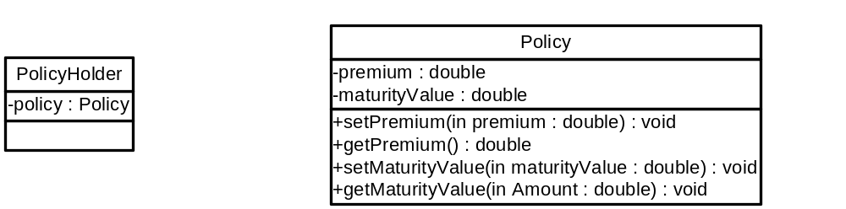
Has-A Relationship
PolicyHolder has a Policy
  The class PolicyHolder has a Policy object as a member variable
Has-A relationship is represented with a diamond headed line in UML

Slide 44
Has-A
public class PolicyHolder{
private Policy policy;
//Other Members
}

Slide 45
Uses-A
Uses-A relationship occurs when one class interacts with another
  Loosely coupled relationship
  A method of a class creates an object of the other class
  A method of a class invokes the method on an object of the other class
Examples:
  Policy uses Calendar for calculating the maturity date of the policy

Slide 46

Uses-A Relationship

Slide 47
Is-A
Is-A Relationship or Inheritance occurs when a class is similar to another class
  A class is a different type of another class

Slide 48
Inheritance (1/3)
Assume that we require a class TermInsurancePolicy
  Needs all the features of the class Policy
  TermInsurancePolicy will have a pre defined number of years before they expire
  Needs to add an extra data called term and relevant methods
  No need to write from the scratch
The keyword extends is used in Java to inherit a sub class from a super class
public class TermInsurancePolicy extends Policy{
//Data Members and Methods
}
Notes:
When the programmer wants to create a new class that needs all the properties of an existing class with some more extra features, the new class need not be programmed from the scratch. Instead the new class can be inherited from the old class using the keyword extends. The programmer needs to add only the additional features needed by the new class. Inheritance leads to code re-usability.

Slide 49
Inheritance (2/3)
The class Policy is known as the
  super class
  parent class
The class TermInsurancePolicy is known as
  sub class
  derived class
  child class

Slide 50
Inheritance (3/3)
public class TermInsurancePolicy extends Policy{
private int term;
public void setTerm(int term){
this.term = term;
}
public int getTerm(){
return term;
}
public double getBenefit(){
//Calculate benefit based on
//premium, maturityValue and term
}
}

Slide 51
The protected Access
The method getBenefit() needs to access the data members premium and maturityValue of the class Policy
A class member that has the protected access specifier can be accessed by the sub classes also
  maturityValue and premium should be declared as protected
public class Policy{
protected double premium;
protected double maturityValue;
//Other Members
}
Notes:
The protected access stands in between the private and public access. It is liberal than private but restricted than public. A protected member can be accessed even by the sub classes of that class.

Slide 52
Creating the sub class Object
TermInsurancePolicy policy = new TermInsurancePolicy();
policy.setPremium(100);
policy.setMaturityValue(5000);
policy.setTerm(36);
System.out.println(policy.getBenefit());
A TermInsurancePolicy object can invoke all the public methods of the class Policy and those that are newly added in TermInsurancePolicy
Thus code reusability is achieved

Slide 53
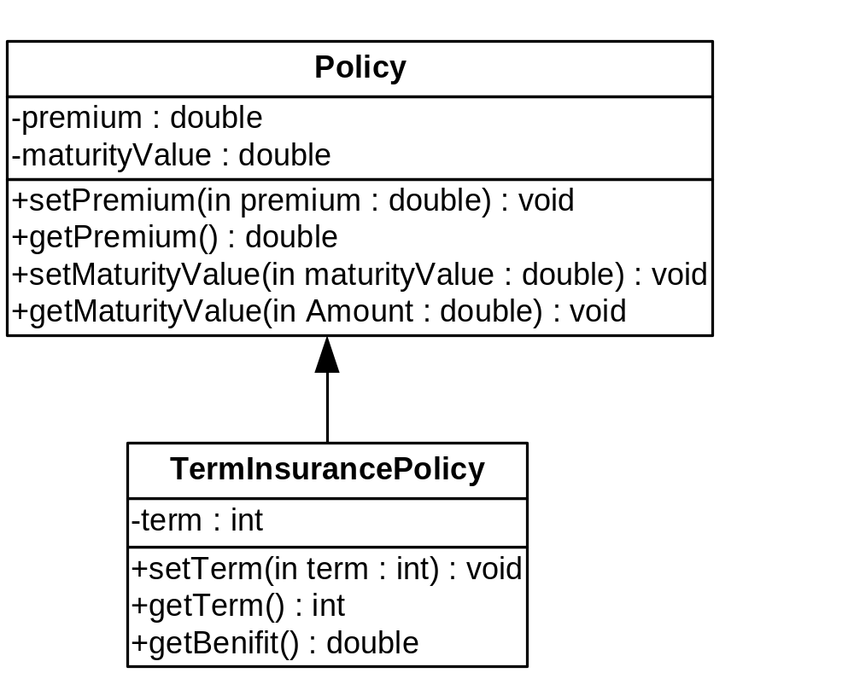
Is-A Relationship - Inheritance
Note: Inheritance is represented by a triangle head arrow in UML Class diagrams

Slide 54
Multi-Level Inheritance
A class can be further inherited from a derived class
  The new class inherits all the member of all its ancestor classes

Slide 55
Multiple Inheritance
Concept of a class inheriting from more than one base class
  A Hybrid car can inherit from FuelCar and BatteryCar
  Multiple inheritance is rarely used because of the complexities it brings in
Modern OO languages like Java and C# don’t support Multiple Inheritance

Slide 56
More on Inheritance
Any number of sub classes can be created from a base class
Consider a class EndowmentPolicy
  EndowmentPolicy is a Policy; EndowmentPolicy is extended from Policy
  Extra data members and methods are added
public class EndowmentPolicy extends Policy{
//Data Members and Methods
}

Slide 57
Generalization and Specialization
To use inheritance
  One has to identify the similarities in different classes
  Move common data and methods to base class
Generalization: Process of identifying the similarities among different classes
  class Policy represents generalization
  Common data and methods of all types of policies are in Policy class
Specialization: Process of creating classes for specific need from a common base class
  Derived classes TermInsurancePolicy and EndowmentPolicy represent specialization
  Specific functionality has been achieved by extending the Policy class
Notes:
While designing the classes, one may identify the base class first and then the sub classes. This is called Specialization. The sub classes are specialized versions of the base class. For example, EndowmentPolicy is a specialized kind of Policy.
Some times, the sub classes will be identified first. A base class is then designed to place all the common features of the sub classes to achieve code reusability. This is called Generalization. The base class is a generalized version of the sub classes. For example, the classes TermInsurancePolicy and EndowmentPolicy are identified by the designer. The designer finds that these classes are having many things in common. It would be better to have a base class called Policy that has all the common features from which TermInsurancePolicy and EndowmentPolicy.

Slide 58
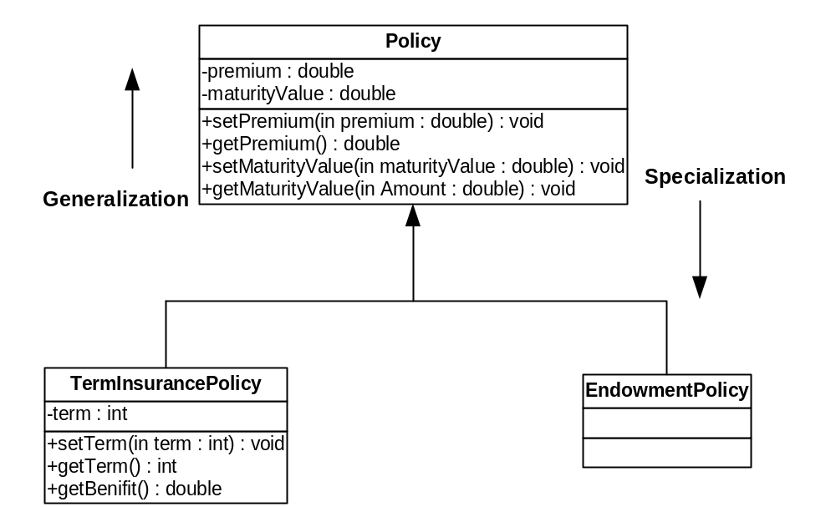
Generalization and Specialization - Example

Slide 59
The Object Class
A class called Object is defined in the java.lang package of the Java standard class library
All classes are derived from the Object class
If a class is not explicitly defined to be the child of an existing class, it is assumed to be the child of the Object class
Therefore, the Object class is the ultimate root of all class hierarchies
Micro-Pro

Slide 60
The Object Class
The Object class contains a few useful methods, which are inherited by all classes
For example, the toString method is defined in the Object class
Every time we have defined toString, we have actually been overriding an existing definition
The toString method in the Object class is defined to return a string that contains the name of the object’s class together along with some other information
  All objects are guaranteed to have a toString method via inheritance, thus the println method can call toString for any object that is passed to it
Micro-Pro

Slide 61
The Object Class
The equals method of the Object class returns true if two references are aliases
We can override equals in any class to define equality in some more appropriate way
The String class (as we've seen) defines the equals method to return true if two String objects contain the same characters
Therefore the String class has overridden the equals method inherited from Object in favor of its own version
Micro-Pro

Slide 62
Summary:
OO SDLC
Classes and Objects
  Abstraction
  Encapsulation
Constructors
Method Overloading
  Polymorphism
Static Members
Command Line Arguments
Class Relationships
  Has A
  Uses A
  Is A (Inheritance)

